Slide 1






AXIE INFINITY

Slide 2
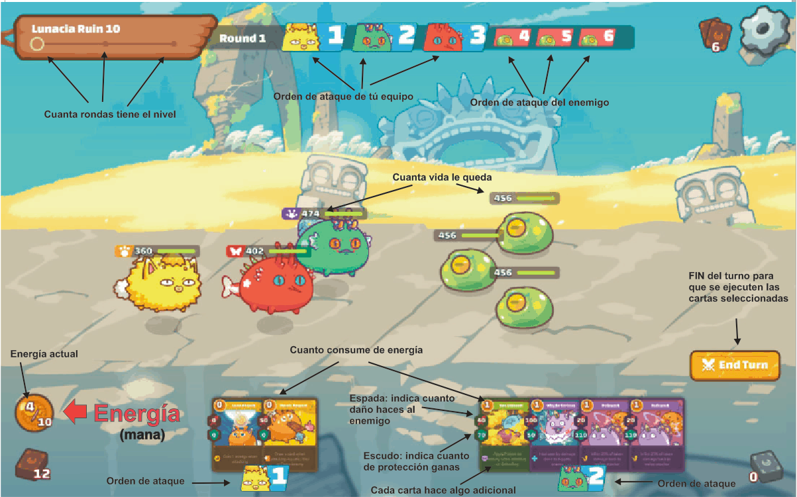


MECANICAS

Slide 3


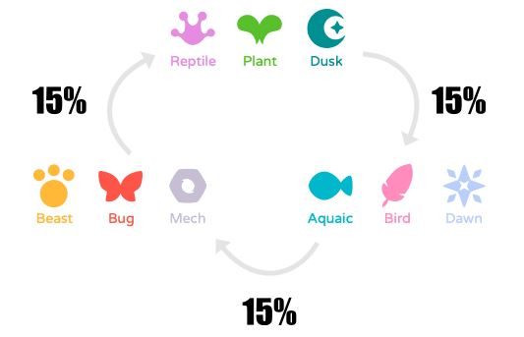


axies
axies

Slide 4
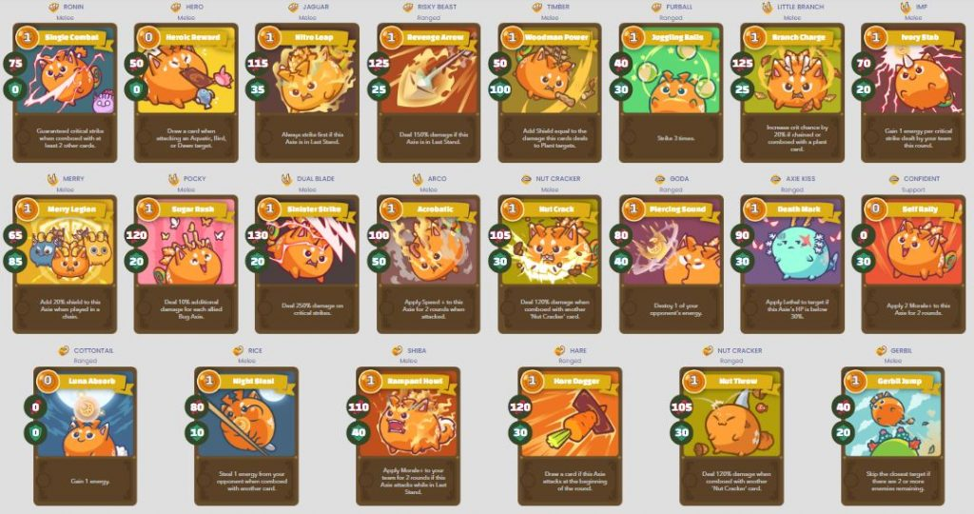

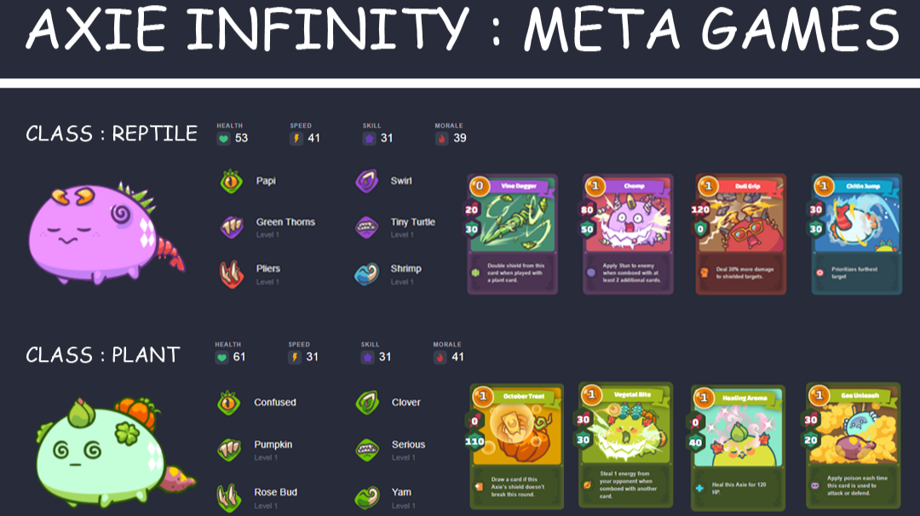
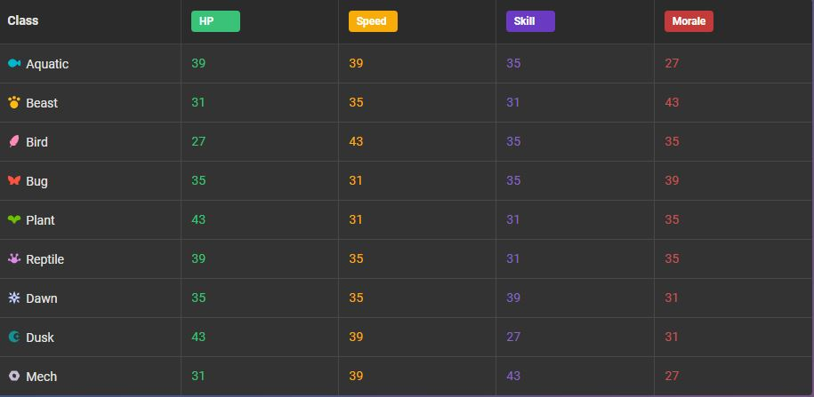
axies

Slide 5

axies

Slide 6

PROFIT

Slide 7
PROFIT

Slide 8
PROFIT

Slide 9
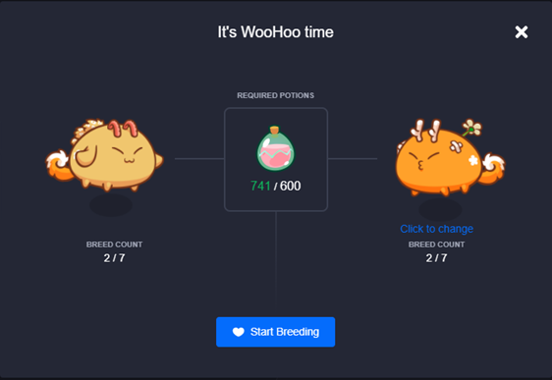
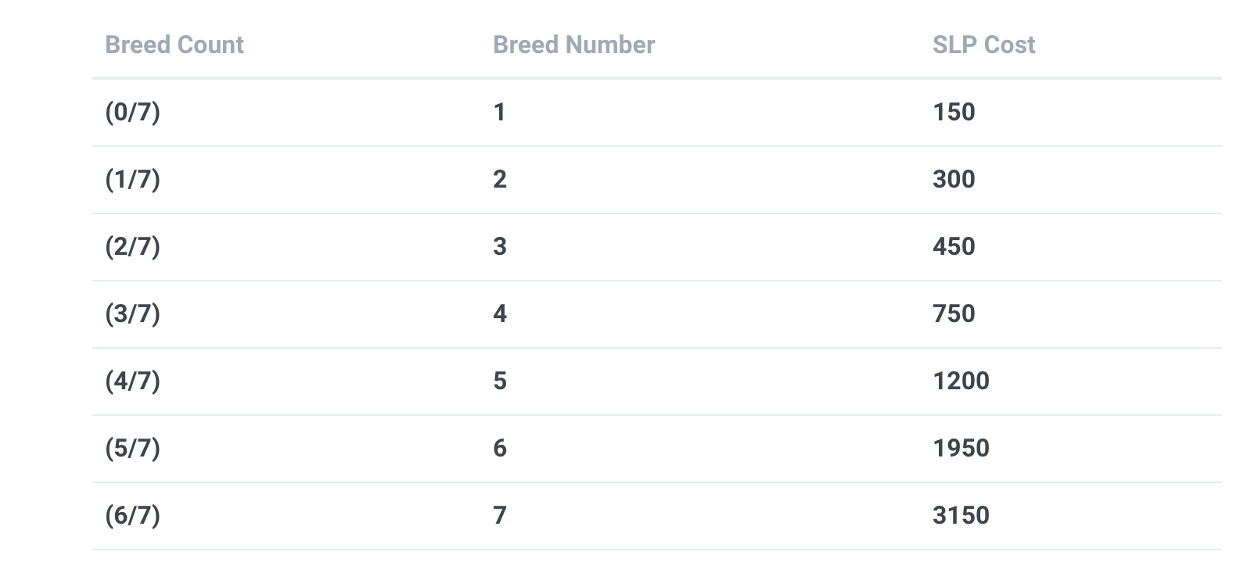
BREED

Slide 10



BREED

Slide 11
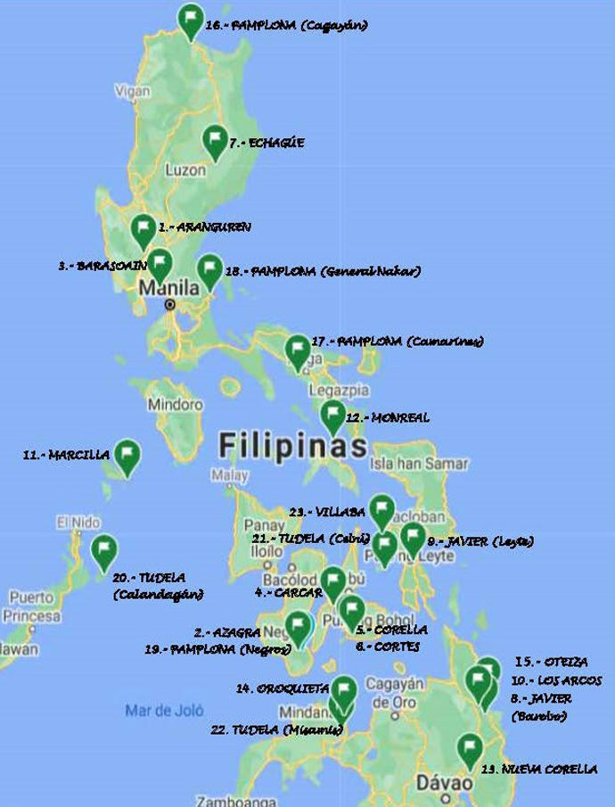
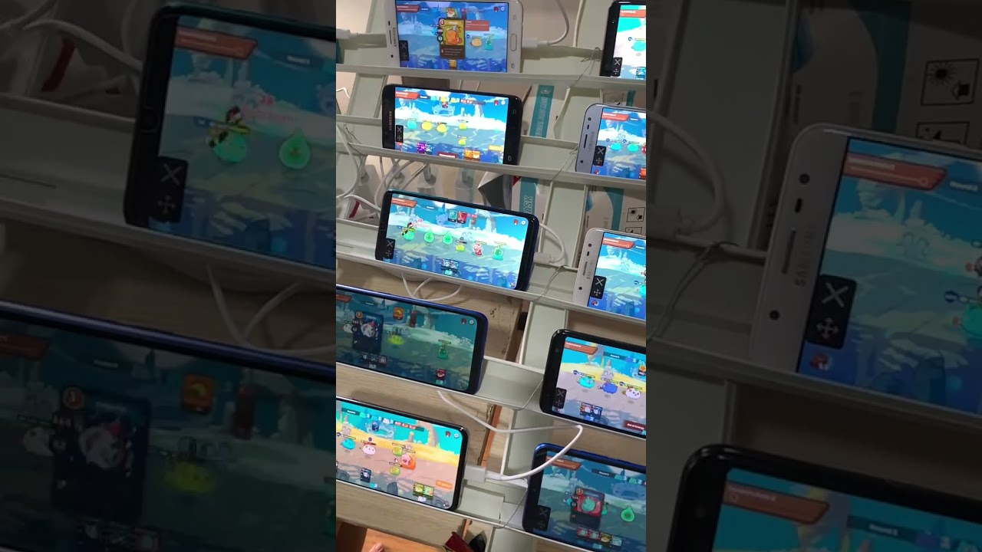
BECAS / SCHOLARSHIPS

Slide 12


lands

Slide 13


PREGUNTAS

